Slide 1
Unit 5 : Data Warehouse to Data Mining
Lecturer : Bijay Mishra

Slide 2

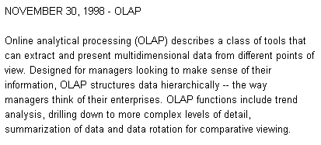
OLAP – Online Analytical Processing
A definition from

Slide 3
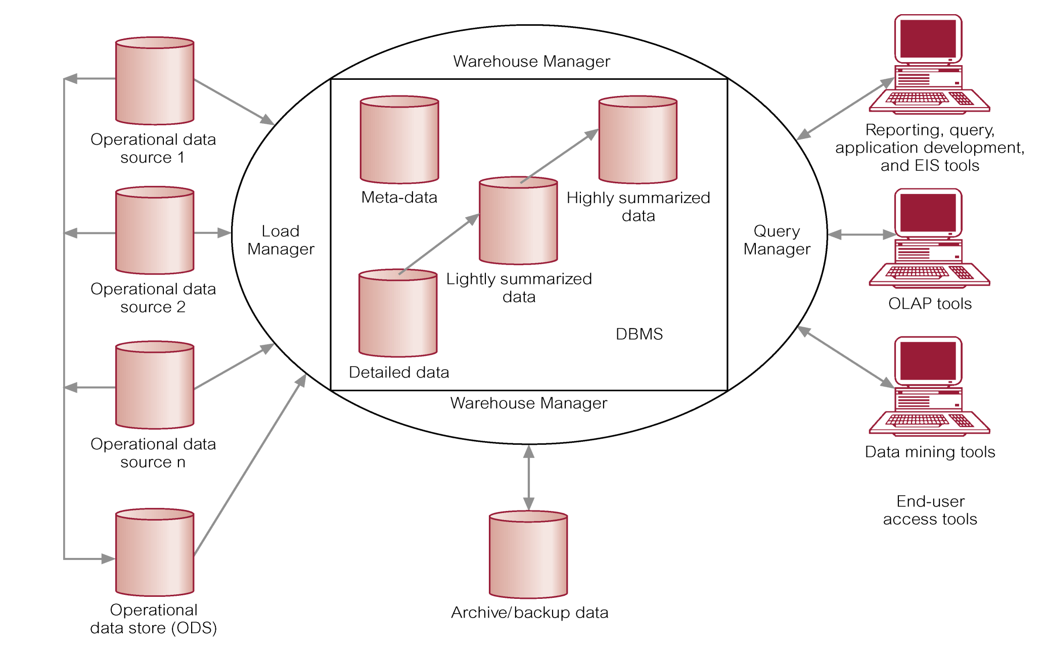
Data Warehouse Architecture

Slide 4
OLAP provides you with a very good view of what is happening, but can not predict what will happen in the future or why it is happening.
OLAP is a term used to describe the analysis of complex data from the data warehouse.
OLAP is an advanced data analysis environment that supports decision making, business modeling, and operations research activities.

Slide 5
Can easily answer ‘who?’ and ‘what?’ questions, however, ability to answer ‘what if?’ and ‘why?’ type questions distinguishes OLAP from general-purpose query tools.
Enables users to gain a deeper understanding and knowledge about various aspects of their corporate data through fast, consistent, interactive access to a wide variety of possible views of the data.
Allows users to view corporate data in such a way that it is a better model of the true dimensionality of the enterprise.

Slide 6
OLAP is a category of applications/technology for
Collecting, managing, processing, and presenting
multidimensional data for analysis and management purposes.
OLAP is FASMI
Fast
Analysis
Shared
Multidimensional
Information

Slide 7
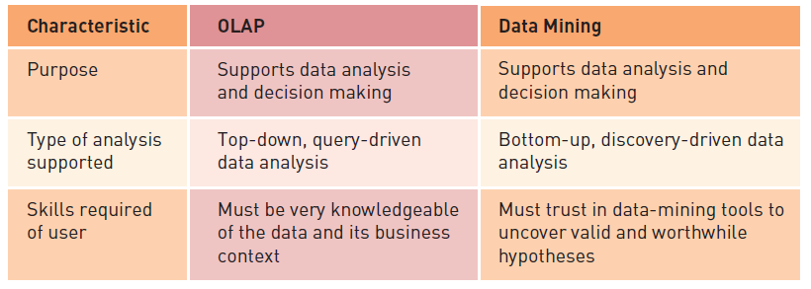
Comparing OLAP and Data Mining

Slide 8
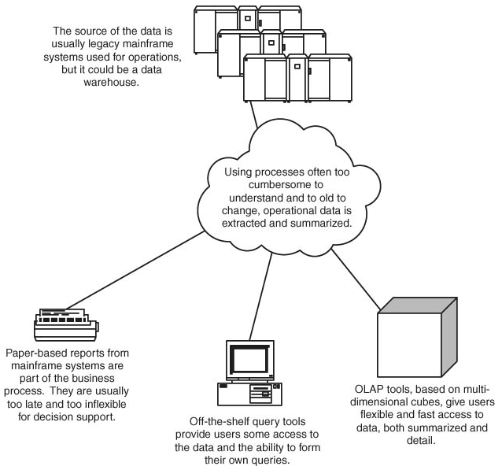
Where does OLAP fit in?

Slide 9
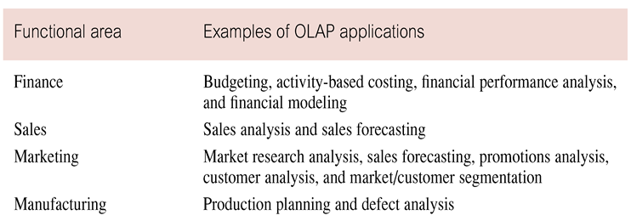
Examples of OLAP Applications in Various Functional Areas

Slide 10
OLAP Benefits
Increased productivity of end-users.
Retention of organizational control over the integrity of corporate data.
Reduced query drag and network traffic on OLTP systems or on the data warehouse.
Improved potential revenue and profitability.

Slide 11
Strengths of OLAP
It is a powerful visualization paradigm
It provides fast, interactive response times
It is good for analyzing time series
It can be useful to find some clusters and outliers
Many vendors offer OLAP tools

Slide 12
OLAP for Decision Support
Goal of OLAP is to support ad-hoc querying for the business analyst
Business analysts are familiar with spreadsheets
Extend spreadsheet analysis model to work with warehouse data
Large data set
Semantically enriched to understand business terms (e.g., time, geography)
Combined with reporting features
Multidimensional view of data is the foundation of OLAP

Slide 13
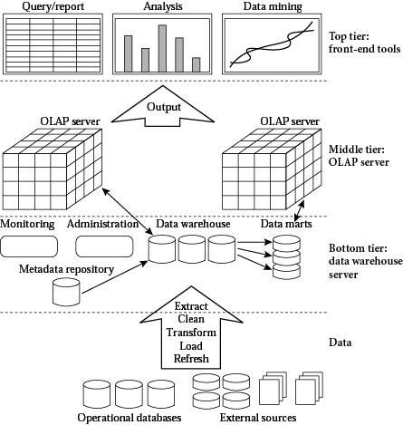
OLAP Architecture

Slide 14
OLAP Architecture (continued)
Designed to use both operational and data warehouse data
Defined as an “advanced data analysis environment that supports decision making, business modeling, and an operation’s research activities”
In most implementations, data warehouse and OLAP are interrelated and complementary environments

Slide 15
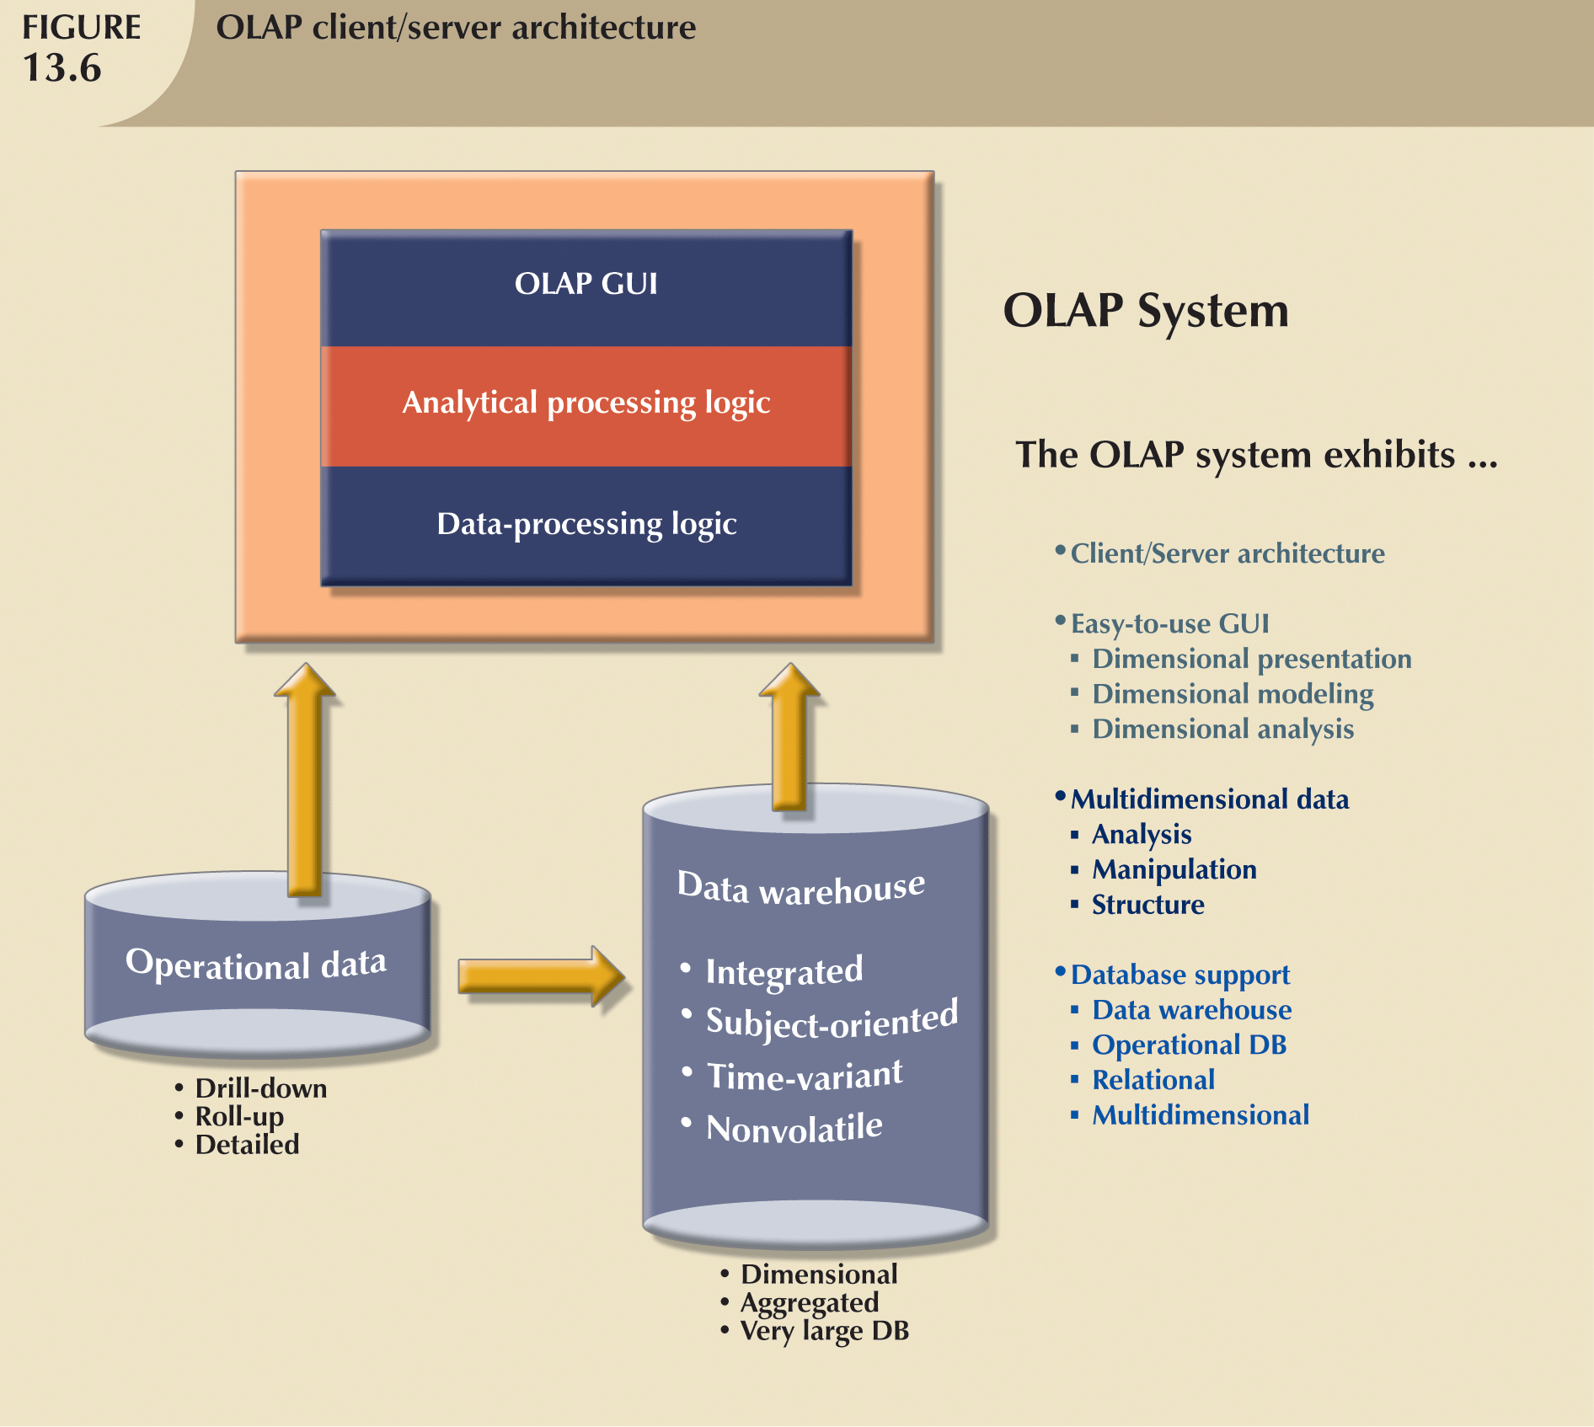
OLAP Client/Server Architecture

Slide 16
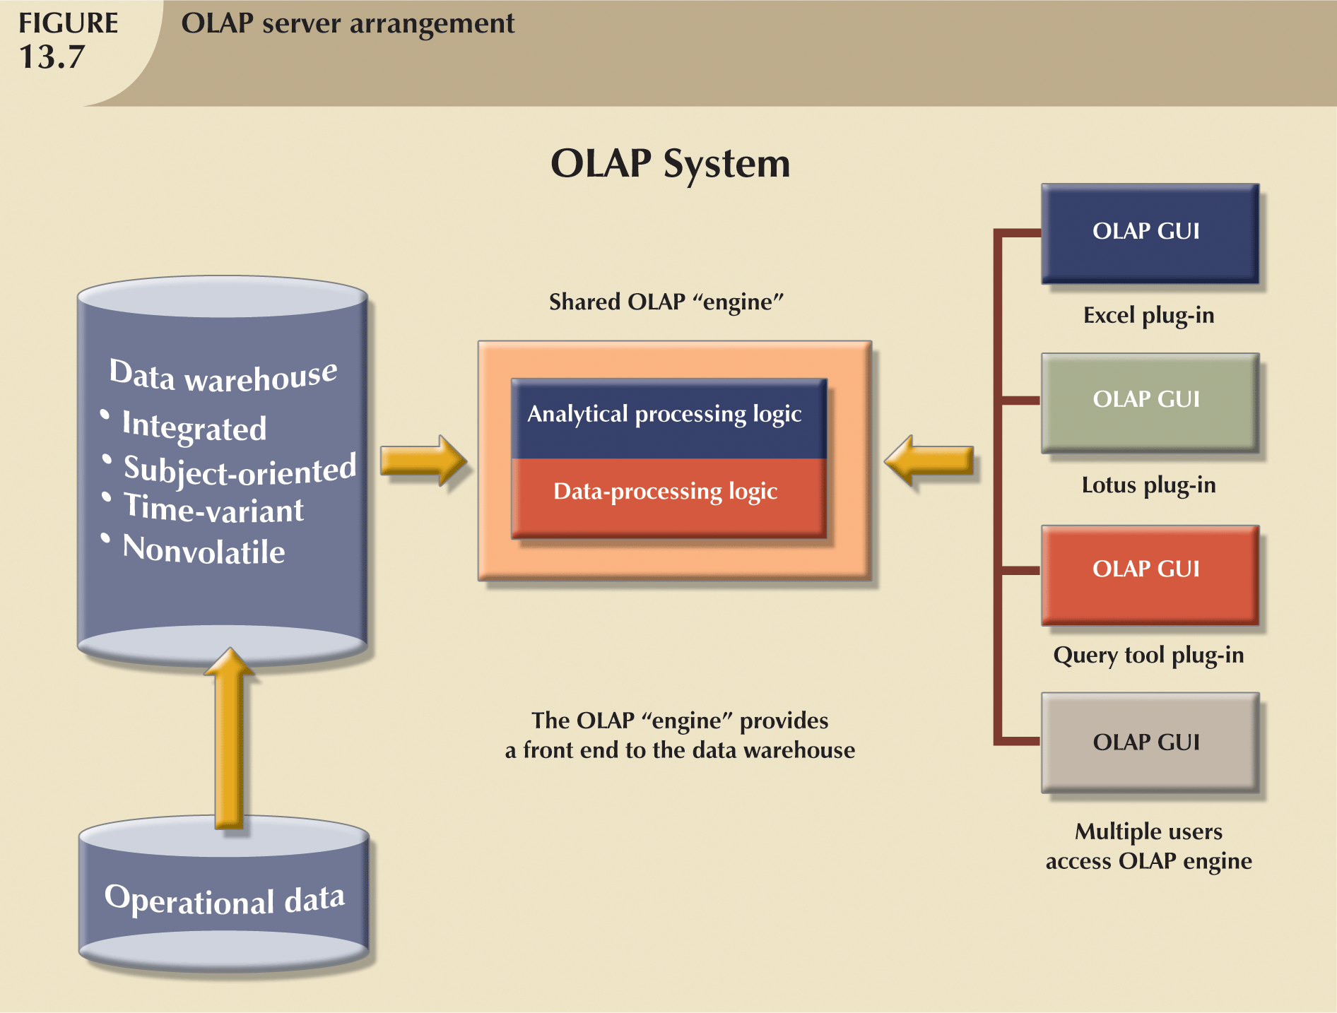

Slide 17
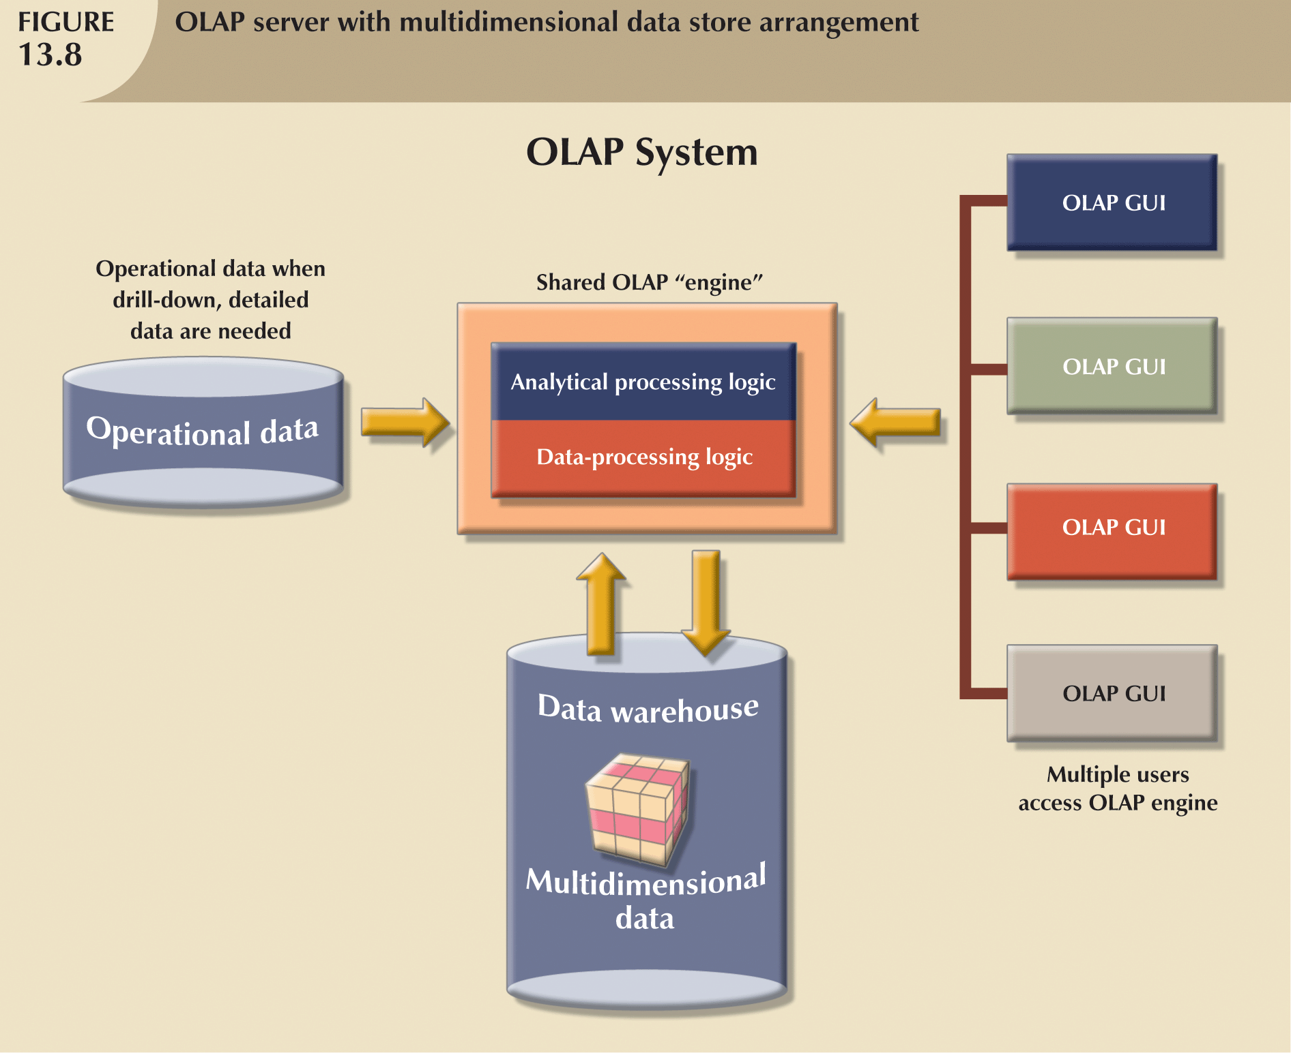

Slide 18
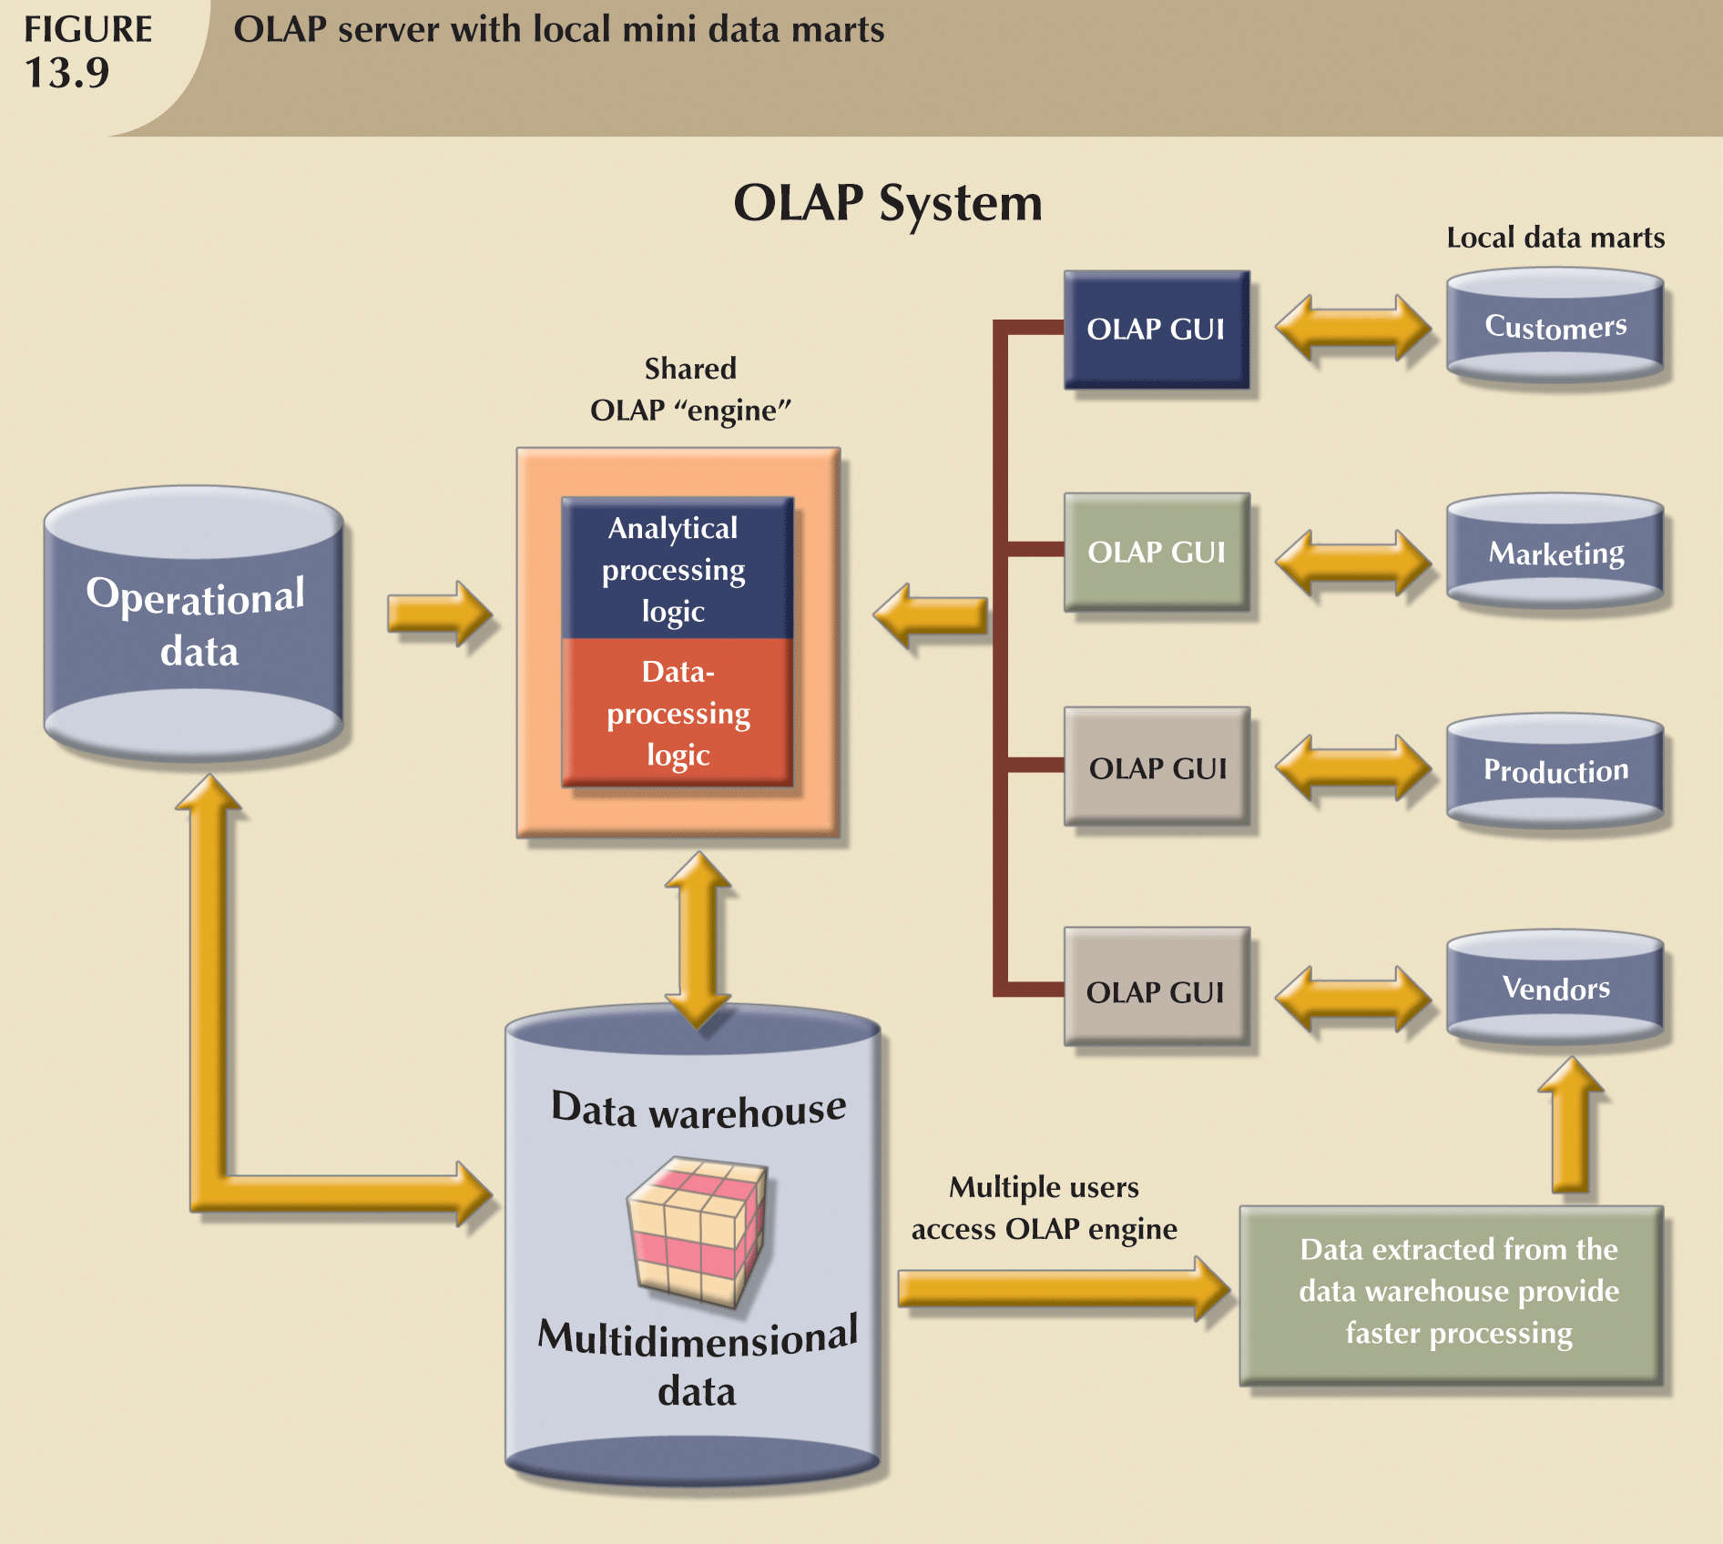

Slide 19
On-Line Analytical Mining (OLAM)
On-line analytical mining (OLAM) (also called OLAP mining) integrates on-line analytical processing (OLAP) with data mining and mining knowledge in multidimensional databases.
OLAM is particularly important for the following reasons:
High quality of data in data warehouses
Available information processing infrastructure surrounding data warehouses
OLAP-based exploratory data analysis
On-line selection of data mining functions

Slide 20
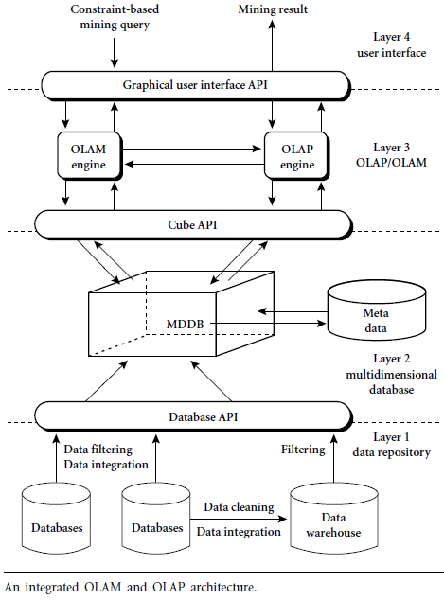
Figure

Slide 21
An OLAM server performs analytical mining in data cubes in a similar manner as an OLAP server performs on-line analytical processing.
An integrated OLAM and OLAP architecture is shown in figure above, where the OLAM and OLAP servers both accept user on-line queries (or commands) via a graphical user interface API and work with the data cube in the data analysis via a cube API.

Slide 22
A metadata directory is used to guide the access of the data cube.
The data cube can be constructed by accessing and/or integrating multiple databases via an MDDB API and/or by filtering a data warehouse via a database API that may support OLE DB or ODBC connections.

Slide 23
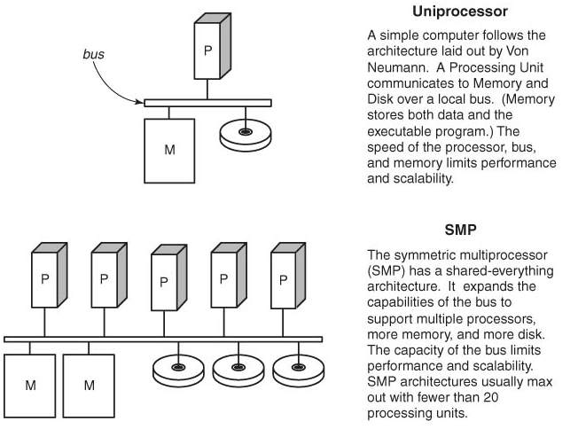
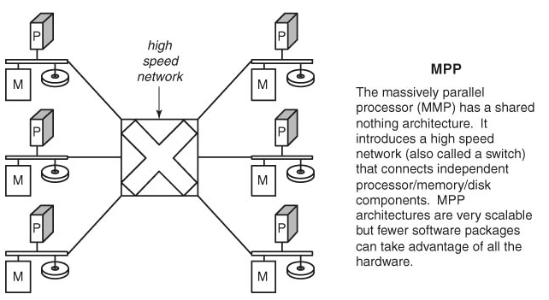
Server Options
Single processor (Uniprocessor)
Symmetric multiprocessor (SMP)
Massively parallel processor (MPP)

Slide 24
OLAP Server Options/Categories of OLAP Tools
OLAP tools are categorized according to the architecture of the underlying database.
Three main categories of OLAP tools includes:
Relational OLAP (ROLAP)
Multi-dimensional OLAP (MOLAP or MD-OLAP)
DOLAP (Desktop OLAP)
Hybrid OLAP (HOLAP )

Slide 25
Relational OLAP (ROLAP)
Relational OLAP (ROLAP) implementations are similar in functionality to MOLAP. However, these systems use an underlying RDBMS, rather than a specialized MDDB. This gives them better scalability since they are able to handle larger volumes of data than the MOLAP architectures. Also, ROLAP implementations typically have better drill-through because the detail data resides on the same database as the multidimensional data .
The ROLAP environment is typically based on the use of a data structure known as a star or snowflake schema. Analogous to a virtual MDDB, a star or snowflake schema is a way of representing multidimensional data in a two-dimensional RDBMS.

Slide 26
The data modeler builds a fact table, which is linked to multiple dimension tables. The dimension tables consist almost entirely of keys, such as location, time, and product, which point back to the detail records stored in the fact table. This type of data structure requires a great deal of initial planning and set up, and suffers from some of the same operational and flexibility concerns of MDDBs. Additionally, since the data structures are relational, SQL must be used to access the detail records.
Therefore, the ROLAP engine must perform additional work to do comparisons, such as comparing the current quarter with this quarter last year. Again, IT must be heavily involved in defining, implementing, and maintaining the database. Furthermore, the ROLAP architecture often restricts the user from performing OLAP operations in a mobile environment

Slide 27
Relational Online Analytical Processing (ROLAP)
OLAP functionality using relational database and familiar query tools to store and analyze multidimensional data
Adds following extensions to traditional RDBMS:
Multidimensional data schema support within RDBMS
Data access language and query performance optimized for multidimensional data
Support for Very Large Databases
Tune a relational DBMS to support star schemas.
Frontend
Tool
MD-Interface
ROLAP-
Engine
Meta Data
SQL
Relational DB

Slide 28
ROLAP is a fastest growing style of OLAP technology.
Supports RDBMS products using a metadata layer - avoids need to create a static multi-dimensional data structure - facilitates the creation of multiple multi-dimensional views of the two-dimensional relation.
To improve performance, some products use SQL engines to support complexity of multi-dimensional analysis, while others recommend, or require, the use of highly denormalized database designs such as the star schema.

Slide 29
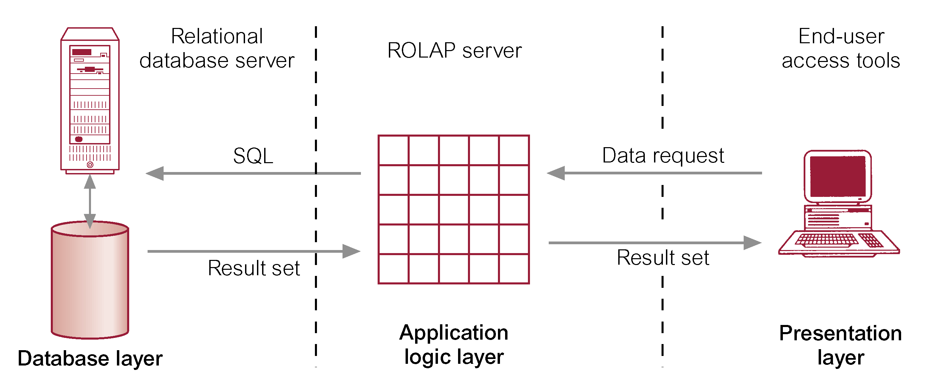
Typical Architecture for ROLAP Tools

Slide 30
With ROLAP data remains in the original relational tables, a separate set of relational tables is used to store and reference aggregation data. ROLAP is ideal for large databases or legacy data that is infrequently queried.
ROLAP Products:
IBM DB2, Oracle, Sybase IQ, RedBrick, Informix
ROLAP Tools
ORACLE 8i
ORACLE Reports; ORACLE Discoverer
ORACLE Warehouse Builder
Arbors Software’s Essbase

Slide 31
Advantages of ROLAP
Define complex, multi-dimensional data with simple model
Reduces the number of joins a query has to process
Allows the data warehouse to evolve with rel. low maintenance
HOWEVER! Star schema and relational DBMS are not the magic solution
Query optimization is still problematic

Slide 32
Features of ROLAP:
Ask any question (not limited to the contents of the cube)
Ability to drill down
Downsides of ROLAP:
Slow Response
Some limitations on scalability

Slide 33
Multi-Dimensional OLAP (MOLAP)
The first generation of server-based multidimensional OLAP (MOLAP) solutions use multidimensional databases (MDDBs). The main advantage of an MDDB over an RDBMS is that an MDDB can provide information quickly since it is calculated and stored at the appropriate hierarchy level in advance. However, this limits the flexibility of the MDDB since the dimensions and aggregations are predefined. If a business analyst wants to examine a dimension that is not defined in the MDDB, a developer needs to define the dimension in the database and modify the routines used to locate and reformat the source data before an operator can load the dimension data.

Slide 34
Another important operational consideration is that the data in the MDDB must be periodically updated to remain current. This update process needs to be scheduled and managed. In addition, the updates need to go through a data cleansing and validation process to ensure data consistency. Finally, an administrator needs to allocate time for creating indexes and aggregations, a task that can consume considerable time once the raw data has been loaded. (These requirements also apply if the company is building a data warehouse that is acting as a source for the MDDB.)
Organizations typically need to invest significant resources in implementing MDDB systems and monitoring their daily operations. This complexity adds to implementation delays and costs, and requires significant IT involvement. This also results in the analyst, who is typically a business user, having a greater dependency on IT. Thus, one of the key benefits of this OLAP technology — the ability to analyze information without the use of IT professionals — may be significantly diminished.

Slide 35
Uses specialized data structures and multi-dimensional Database Management Systems (MD-DBMSs) to organize, navigate, and analyze data.
Use a specialized DBMS with a model such as the “data cube.”
Data is typically aggregated and stored according to predicted usage to enhance query performance.
Front-end
Tool
Multidimensional
Database

Slide 36
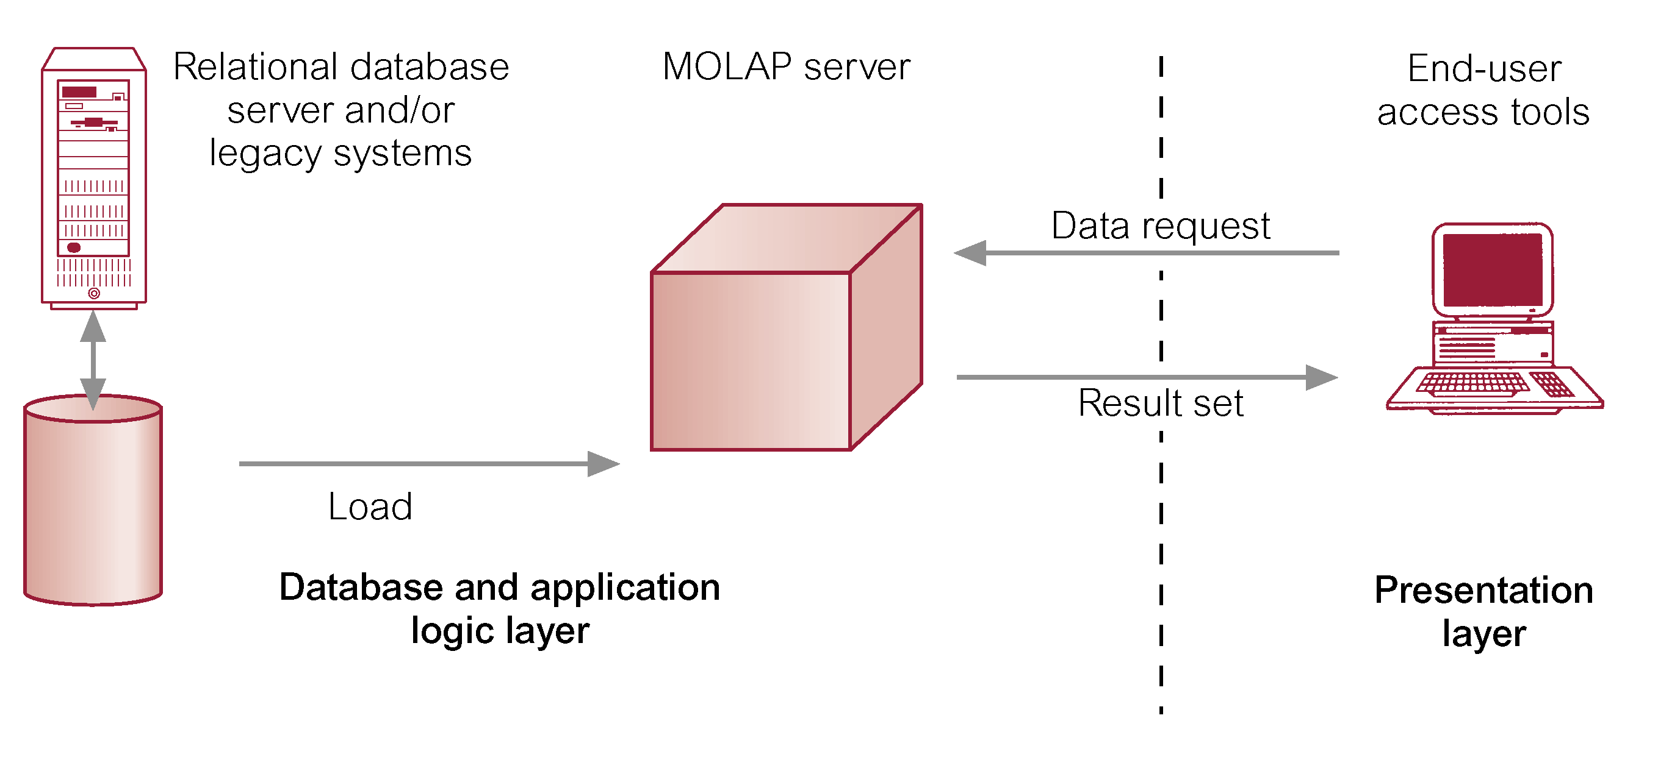
Typical Architecture for MOLAP Tools

Slide 37
Traditionally, require a tight coupling with the application layer and presentation layer.
Recent trends segregate the OLAP from the data structures through the use of published application programming interfaces (APIs).
MOLAP Products
Pilot, Arbor Essbase, Gentia
MOLAP Tools
ORACLE Express Server
ORACLE Express Clients (C/S and Web)
MicroStrategy’s DSS server
Platinum Technologies’ Plantinum InfoBeacon

Slide 38
Use array technology and efficient storage techniques that minimize the disk space requirements through sparse data management.
Provides excellent performance when data is used as designed, and the focus is on data for a specific decision-support application.
Features:
Very fast response
Ability to quickly write data into the cube
Downsides:
Limited Scalability
Inability to contain detailed data
Load time

Slide 39
Desktop OLAP (or Client OLAP)
The desktop OLAP market resulted from the need for users to run business queries using relatively small data sets extracted from production systems. Most desktop OLAP systems were developed as extensions of production system report writers, while others were developed in the early days of client/server computing to take advantage of the power of the emerging (at that time) PC desktop. Desktop OLAP systems are popular and typically require relatively little IT investment to implement. They also provide highly mobile OLAP operations for users who may work remotely or travel extensively. However, most are limited to a single user and lack the ability to manage large data sets.

Slide 40
Client-
OLAP
proprietary data structure on the client
data stored as file
mostly RAM based architectures
mobile user
ease of installation and use
data volume
no multiuser capabilities
Stores in the form of cubes/micro-cubes on the desktop/client machine
Products:
Brio.Enterprise
BusinessObjects
Cognos PowerPlay

Slide 41
Hybrid OLAP (HOLAP)
Some vendors provide the ability to access relational databases directly from an MDDB, giving rise to the concept of hybrid OLAP environments. This implements the concept of "drill through," which automatically generates SQL to retrieve detail data records for further analysis. This gives end users the perception they are drilling past the multidimensional database into the source database.
The hybrid OLAP system combines the performance and functionality of the MDDB with the ability to access detail data, which provides greater value to some categories of users. However, these implementations are typically supported by a single vendor’s databases and are fairly complex to deploy and maintain. Additionally, they are typically somewhat restrictive in terms of their mobility.

Slide 42
Can use data from either a RDBMS directly or a multi-dimension server.
Equal treatment of MD and Relational Data
Storage type at the discretion of the administrator
Cube Partitioning
HOLAP System
Meta Data
Multidimensional Storage
Relational Storage

Slide 43
HOLAP combines elements from MOLAP and ROLAP. HOLAP keeps the original data in relational tables but stores aggregations in a multidimensional format.
Combines MOLAP & ROLAP
Utilizes both pre-calculated cubes & relational data sources
HOLAP Tools
ORACLE 8i
ORACLE Express Serve
ORACLE Relational Access Manager
ORACLE Express Clients (C/S and Web)
HOLAP Products:
Oracle Express
Seagate Holos
Speedware Media/M
Microsoft OLAP Services

Slide 44
HOLAP Features:
For summary type info – cube, (Faster response)
Ability to drill down – relational data sources (drill through detail to underlying data)
Source of data transparent to end-user

Slide 45
OLAP Products
OLAP Category | Candidate Products | Vendor
ROLAP | Microstrategy | Microstrategy
 | Business Objects | Business Objects
 | Crystal Holos (ROLAP Mode) | Business Objects
 | Essbase | Hyperion
 | Microsoft Analysis Services | Microsoft
 | Oracle Express (ROLAP Mode) | Oracle
 | Oracle Discoverer | Oracle
MOLAP | Crystal Holos | Business Objects
 | Essbase | Hyperion
 | Microsoft Analysis Services | Microsoft
 | Oracle Express | Oracle
 | Cognos Powerplay | Cognos
HOLAP | Hyperion Essbase+Intelligence | Hyperion
 | Cognos Powerplay+Impromptu | Cognos
 | Business Objects+Crystal Holos | Business Objects

Slide 46
Typical OLAP Operations
Roll up (drill-up) or Aggregation: summarize data
by climbing up hierarchy or by dimension reduction
Data is summarized with increasing generalization
dimension reduction: e.g., total sales by city
summarization over aggregate hierarchy: e.g., total sales by city and year -> total sales by region and by year
Drill down (roll down): reverse of roll-up
from higher level summary to lower level summary or detailed data, or introducing new dimensions
going from summary to more detailed views
Increasing levels of detail are revealed
Slice and Dice:
project and select
Performing projection operations on the dimensions.
Pivot (rotate):
reorient the cube, visualization, 3D to series of 2D planes.
Cross tabulation is performed
Other operations:
drill across: involving (across) more than one fact table
drill through: through the bottom level of the cube to its back-end relational tables (using SQL)

Slide 47
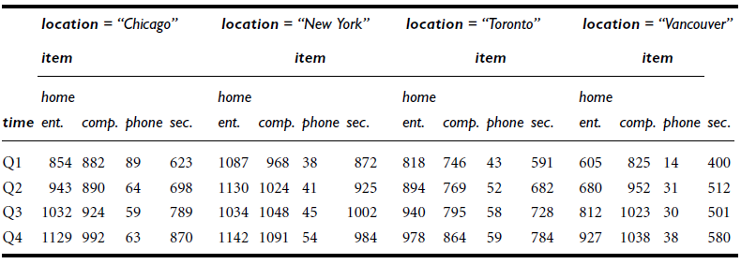
Table: A 3-D view of sales data according to the dimensions time, item, and location. The measure displayed is dollars sold (in thousands).

Slide 48
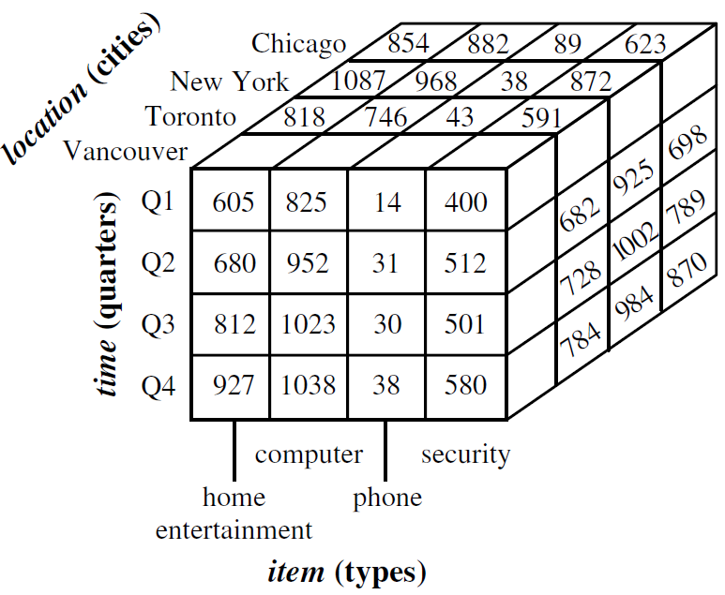
Figure: A 3-D data cube representation of the data in the table above, according to the dimensions time, item, and location. The measure displayed is dollars sold (in thousands).

Slide 49
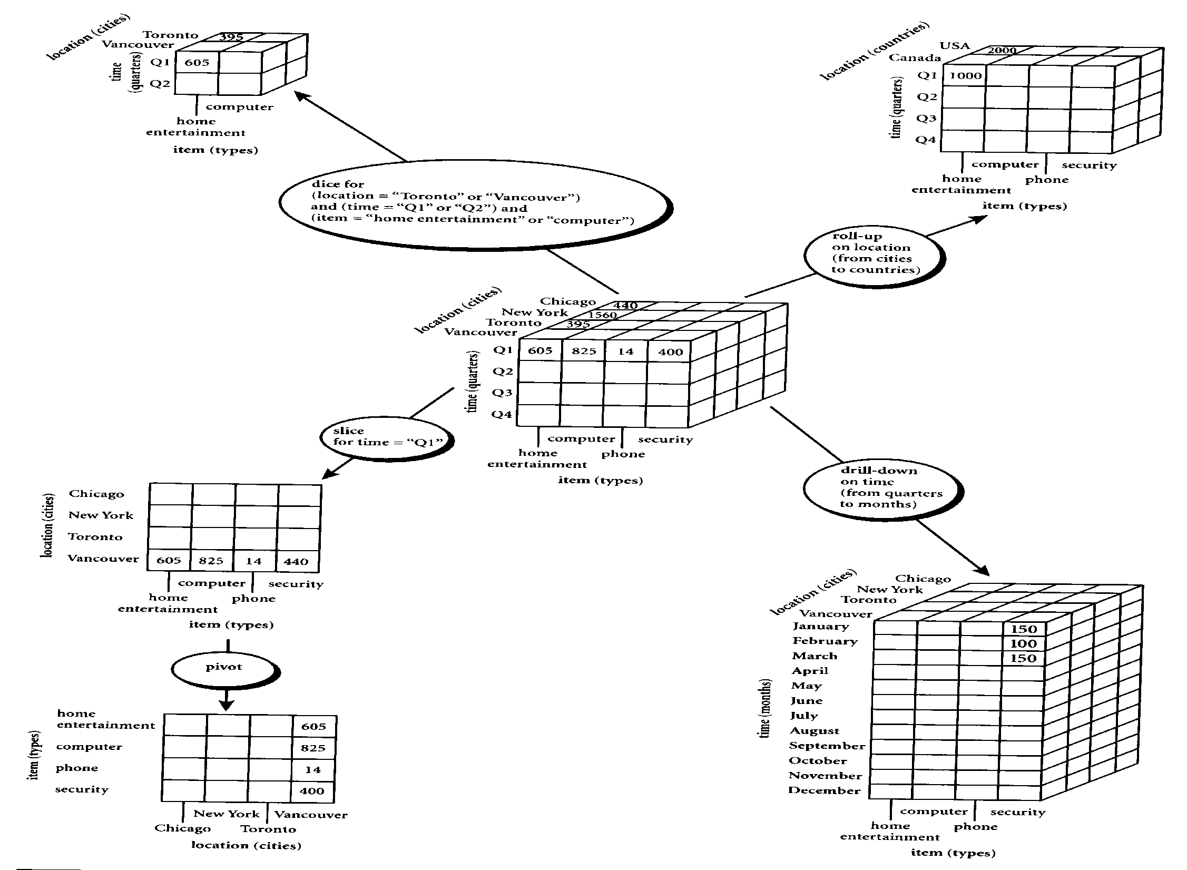
Figure: Examples of typical OLAP operations on multidimensional data

Slide 50
Roll-up and Drill-down
The roll-up operation performs aggregation on a data cube, either by climbing up a concept hierarchy for a dimension or by dimension reduction such that one or more dimensions are removed from the given cube.
Drill-down is the reverse of roll-up. It navigates from less detailed data to more detailed data. Drill-down can be realized by either stepping down a concept hierarchy for a dimension or introducing additional dimensions.

Slide 53
Drill Down Example

Slide 54
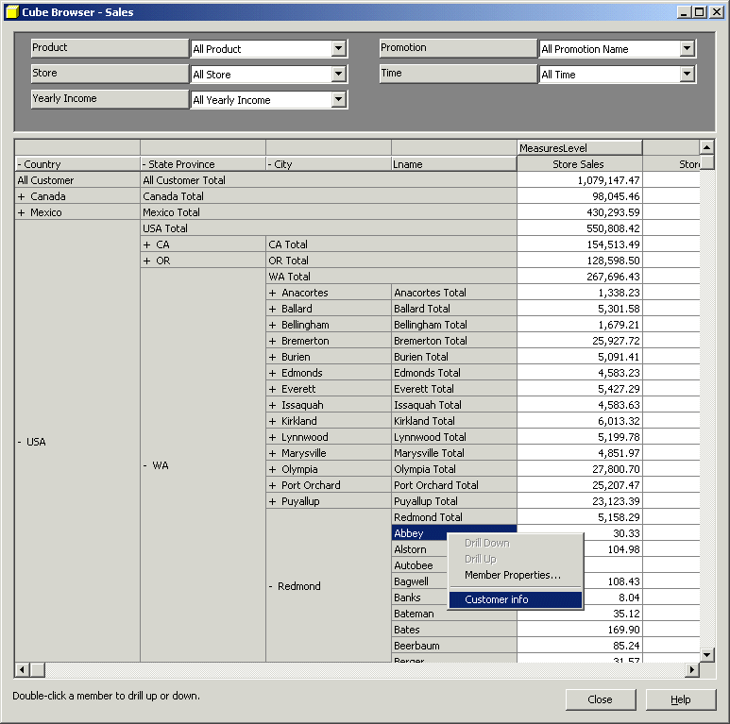
Sample OLAP Drill down online report

Slide 55
Figure:
Example of drill-down
Quarterly Auto Sales Summary
Region
Northeast
Southeast
Central
Northwest
Southwest
Units Sold
Revenue
Quarterly Auto Sales Summary
Region
Northeast
Southeast
State
Maine
New York
Massachusetts
Florida
Georgia
Virginia
Units Sold
Revenue

Slide 56
Figure:
Example of Roll up
Quarterly Auto Sales Summary
Region
Northeast
Southeast
State
Maine
New York
Massachusetts
Florida
Georgia
Virginia
Units Sold
Revenue
Quarterly Auto Sales Summary
Region
Northeast
Southeast
Central
Northwest
Southwest
Units Sold
Revenue

Slide 57
Slice and Dice
The slice operation performs a selection on one dimension of the given cube, resulting in a sub cube.
The dice operation defines a sub cube by performing a selection on two or more dimensions.

Slide 60
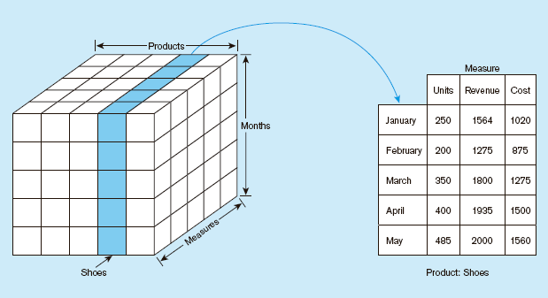
Figure: Slicing a data cube

Slide 61
Rotation (Pivot Table)
Product
Product
Region
Time
Time
Region

Slide 62
Example of Rotation (Pivot Table)

Slide 63
Design and Query Processing
Requirement
Analysis
Using the Data Warehouse
Implementation
Conceptual Design
(Implementation
Independent)
Logical + Physical Design
(e.g. Product specific)

Slide 64
Cube Operation
Cube definition and computation in DMQL
define cube sales[item, city, year]: sum(sales_in_dollars)
compute cube sales
Transform it into a SQL-like language (with a new operator cube by)
SELECT item, city, year, SUM (amount)
FROM SALES
CUBE BY item, city, year

Slide 65
Aggregate a measure on one or more dimension
Summarize at different levels of a dimension hierarchy (state - city)
Total sales per city aggregated to obtain Total sales per State - roll-up
Total sales per state probed further to obtain Total sales per city - drill-down
Slicing - an equality selection on one or more dimensions, possibly also with some dimensions projected out
Dicing - range selection

Slide 66
Note: k dimensions, lead to 2^{k} SQL queries

Slide 67
SQL extension for OLAP
Aggregates
Add up amounts for day 1
In SQL: SELECT sum(amt) FROM SALE
WHERE date = 1
81

Slide 68
Add up amounts by day
In SQL: SELECT date, sum(amt) FROM SALE
GROUP BY date

Slide 69
Add up amounts by day, product
In SQL: SELECT date, sum(amt) FROM SALE
GROUP BY date, prodId
rollup
drill-down
Operators for Aggregation: sum, count, max, min, median, avg

Slide 70

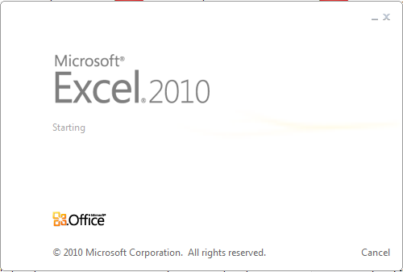




Data Mining Tools

Slide 71
WEKA
WEKA (Waikato Environment for Knowledge Analysis) is a popular suite of machine learning software written in Java, developed at the University of Waikato, New Zealand.
WEKA is free software available under the GNU General Public License.

Slide 72
Features:
Written in JAVA
Has graphical user interfaces
Contains a collection of visualization tools and algorithms for data analysis and predictive modeling
Supports standard data mining tasks like data preprocessing, clustering, classification, regression, visualization, and feature selection
Usage:
Apply a learning method to a dataset & analyze the result
Use a learned model to make predictions on new instances
Apply different learners to a dataset & compare results

Slide 73
MS Excel
In order to bridge the gap between the common user and the complex data mining process, Microsoft has introduced a new and efficient data mining tool ,the Microsoft SQL Server 2005 Data Mining Add-Ins for Office 2007 putting data mining within the reach of every user or desktop.
The add-in can be downloaded from the following link: DOWNLOAD LINK.

Slide 74
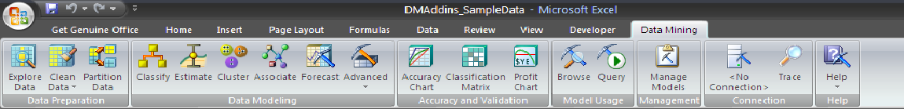
The software pre-requisites for using the add-in are:
Microsoft Office 2007 installed.
Microsoft SQL Server 2005 or above installed.
Microsoft .NET 2.0 framework or higher (for SQL server 2008 only).
Microsoft PowerShell (for SQL server 2008 only)

Slide 75
Once the add-in is installed, you can see the DATA MINING tab in the EXCEL ribbon. The tab contains different options like:
Data Preparation
Explore Data.
Clean Data.
Partition Data.
Data Modeling
Classify.
Estimate.
Cluster.
Associate.
Forecast.
Advanced.
Accuracy and Validation
Accuracy Chart.
Classification Matrix.
Profit Chart.
Model Usage
Browse.
Query.
Management
Connection
No Connection.
Trace.
Help

Slide 76
Conclusion:
The Microsoft SQL Server Data mining add-in for Microsoft Excel provides users with an easy to use interface that is capable of performing complex data mining tasks with ease. The add-in can be extremely useful for both, people who just want to get more out of their data and also for those interested in serious data mining.

Slide 77
Microsoft SQL Server
Microsoft SQL Server is a relational database server, developed by Microsoft: it is a software product whose primary function is to store and retrieve data as requested by other software applications, be it those on the same computer or those running on another computer across a network (including the Internet).

Slide 78
Microsoft has introduced a wealth of new data mining features in Microsoft SQL Server 2008 that allow businesses to answer their concerns with data and mining for information in them.
The current version of SQL Server, SQL Server 2008, (code-named "Katmai") aims to make data management self-tuning, self organizing, and self maintaining.
SQL Server 2008 data mining features are integrated across all the SQL Server products, including SQL Server, SQL Server Integration Services, and Analysis Services.
Accessing the data mining results is as simple as using an SQL-like language called Data Mining Extensions to SQL, or DMX.

Slide 79
Oracle
The Oracle Database (commonly referred to as Oracle RDBMS or simply as Oracle) is an object-relational database management system (ORDBMS) produced and marketed by Oracle Corporation.

Slide 80
Oracle Data Mining (ODM) is used to incorporate data mining with the Oracle database.
ODM is used for both supervised (where a particular target value should be specified) and unsupervised (where patterns in data are observed) data mining.
The results of Oracle Data Mining can be viewed by the Oracle Business Intelligence’s reporting/publishing component.
Oracle BI Standard Edition One is a product that is used to extract business information concealed in the data.

Slide 81
Oracle Warehouse Builder (OWB) is used to create the logical and physical design of the data mart.
The Oracle BI Server is used to build a repository of metadata from the data mart that was created using the Oracle Data warehouse builder.
The users ultimately interact with Oracle BI Answers to extract useful information from the data mart created using OWB (Oracle Warehouse Builder).
Oracle BI Interactive Dashboards are used to publish the data extracted from the data mart so that the users can have an easy access to it.
Oracle BI publisher is used to create reports that are very essential to any kind of business.

Slide 82
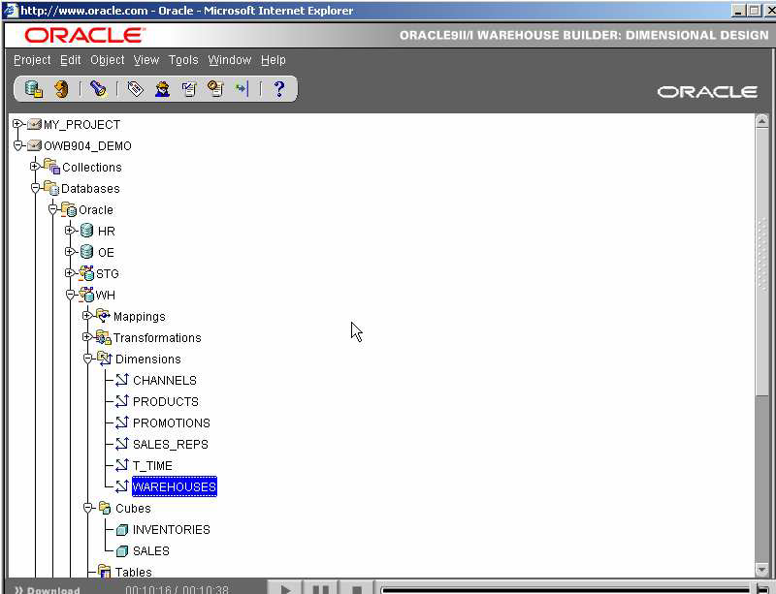

Slide 83
SPSS
SPSS (originally, Statistical Package for the Social Sciences) is a computer program used for survey authoring and deployment (IBM SPSS Data Collection), data mining (IBM SPSS Modeler), text analytics, statistical analysis, and collaboration and deployment (batch and automated scoring services).

Slide 84
Assignments
Discuss the motivation behind OLAP mining (OLAM).
In data warehouse technology, a multiple dimensional view can be implemented by a relational database technique (ROLAP), or by a multidimensional database technique (MOLAP), or by a hybrid database technique (HOLAP).
(a) Briefly describe each implementation technique.
(b) For each technique, explain how each of the following functions may be implemented:
i. The generation of a data warehouse (including aggregation)
ii. Roll-up
iii. Drill-down
iv. Incremental updating
Which implementation techniques do you prefer, and why?

Slide 85
Questions?

Slide 86
References
D. Pyle. Data Preparation for Data Mining. Morgan Kaufmann, 1999.
A. Shoshani. OLAP and statistical databases: Similarities and differences. PODS’00.
J. Han and M. Kamber. Data Mining: Concepts and Techniques. Morgan Kaufmann, 2000.
C. Imhoff, N. Galemmo, and J. G. Geiger. Mastering Data Warehouse Design: Relational and Dimensional Techniques. John Wiley, 2003
W. H. Inmon. Building the Data Warehouse. John Wiley, 1996
R. Kimball and M. Ross. The Data Warehouse Toolkit: The Complete Guide to Dimensional Modeling. 2ed. John Wiley, 2002
R. Agrawal, A. Gupta, and S. Sarawagi. Modeling multidimensional databases. ICDE’97

Slide 87

End of Unit 5

Slide 88
Thank you !!!

